Slide 1
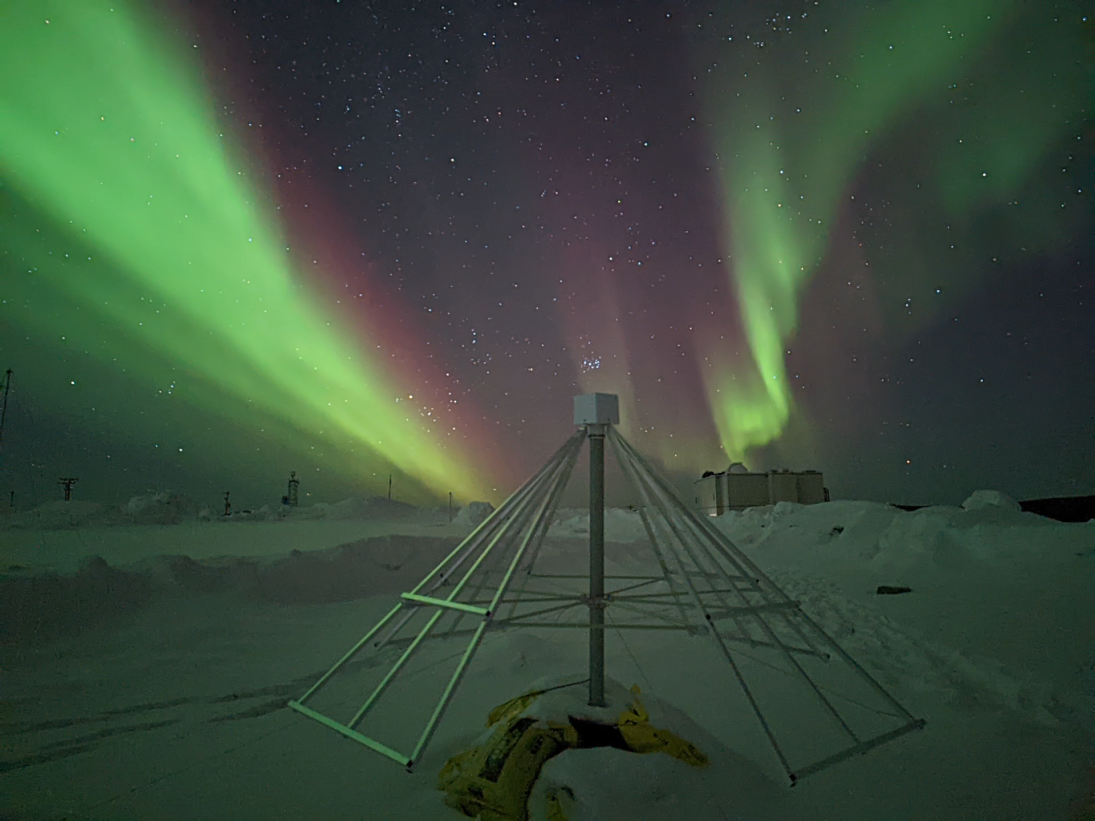
aurora-asi-lib: an open source package providing data access and analysis tools for the world’s all-sky imager (ASI) data
Mykhaylo (Mike) Shumko, Bea Gallardo-Lacourt, Darren Chaddock, Alexa Halford, Eric Donovan, Emma Spanswick, and Kyle Murphy
The Johns Hopkins University Applied Physics Laboratory
19 February 2024

Slide 2
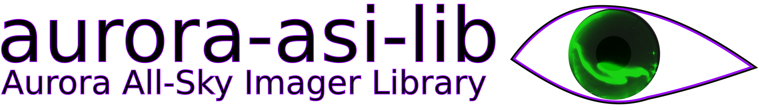
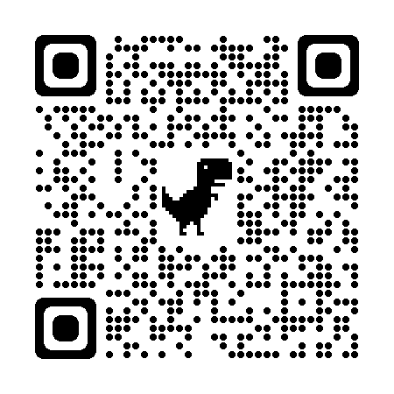
is an open source package utilizing publicly available auroral data to analyze the world’s all-sky imager (ASI) data
Current ASIs supported:
THEMIS
REGO
TREx
The LAMP rocket campaign
Docs!

Slide 3
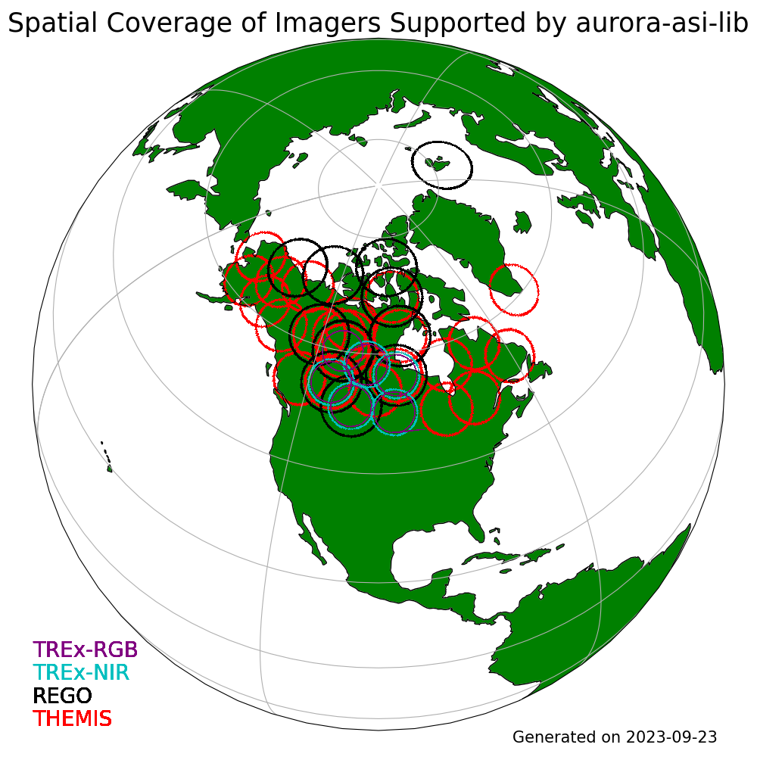
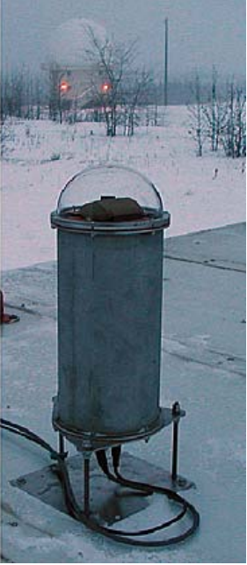
All-sky imagers (ASIs)
A THEMIS ASI

Slide 4
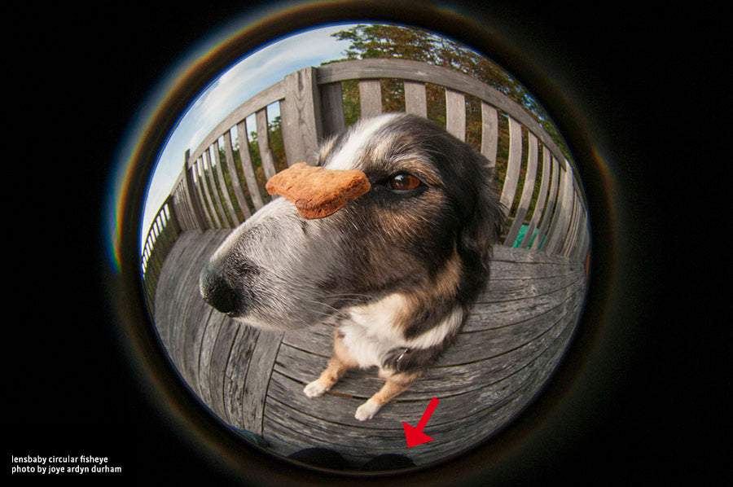
All-sky imagers (ASIs)
A THEMIS ASI
https://lensbaby.com/blogs/creative-photography/circular-fisheye

Slide 5
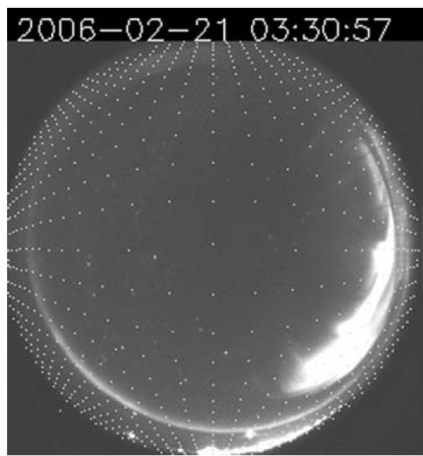
All-sky imagers (ASIs)
A THEMIS ASI
Mende+2008

Slide 6
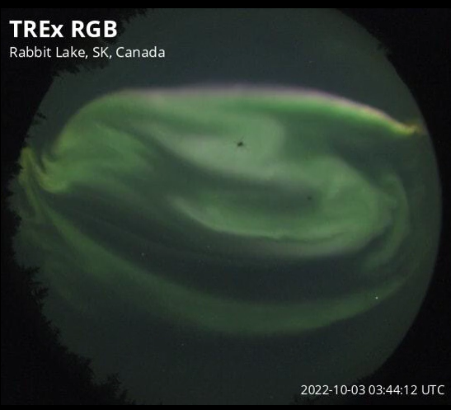
Sometimes bugs get in the way

Slide 7
Live Tutorial

